Slide 1


Quick Guideline
Binaartha Online Trading
Online Trading Web

Slide 2
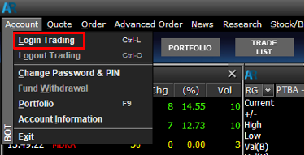
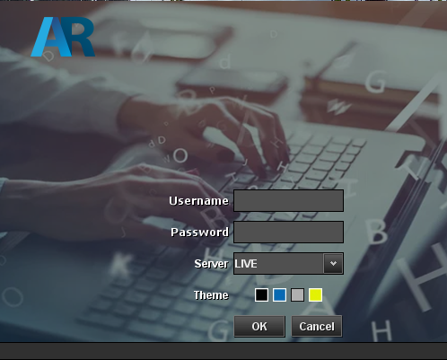
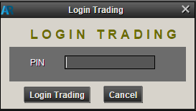
Form Login
Masukkan Username dan Password lalu klik Login
Masukkan PIN Trading

Slide 3
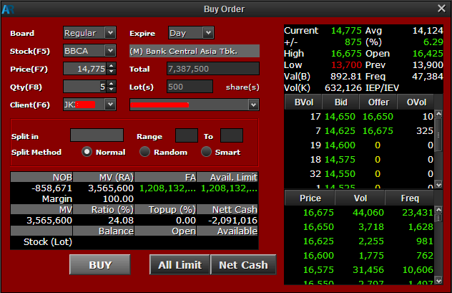
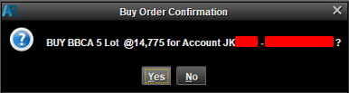
Order Buy
Form Order Buy/Sell
Pilih Buy Order
masukkan harga dan jumlah
Lalu pilih action buy
Konfirmasi Order Buy

Slide 4
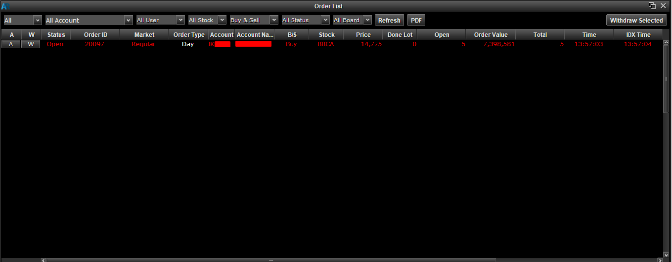
Hasil Order Buy

Slide 5
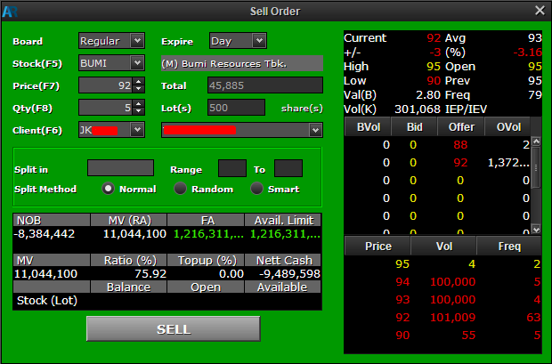
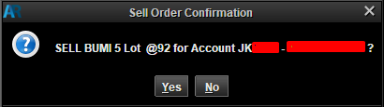
Order Sell
Form Order Sell
Pilih Sell order
masukkan harga dan jumlah
Lalu pilih action sell
Konfirmasi Order Sell

Slide 6
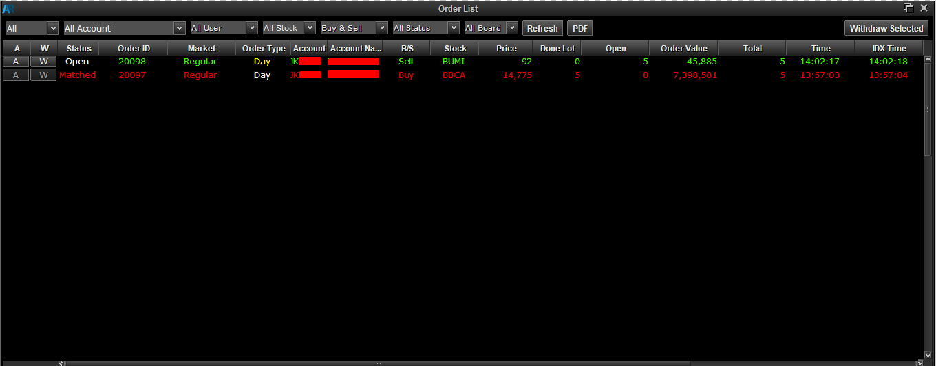
Hasil Order Sell

Slide 7
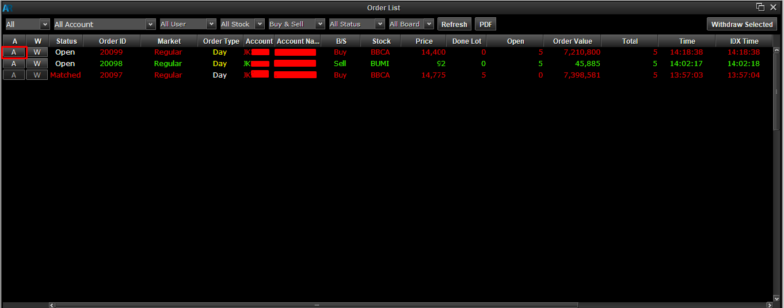
Amend Buy
Amend Buy
Pilih order tipe buy berstatus open yang ingin di-amend lalu pilih Amend

Slide 8
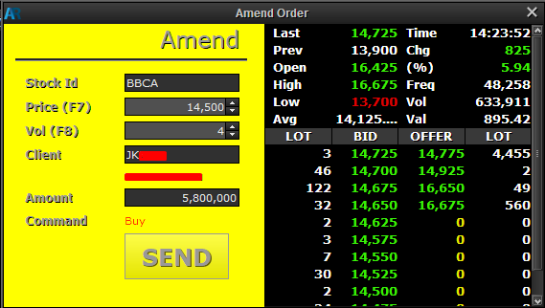
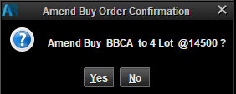
Amend Buy
Proses Amend Buy
Masukkan harga dan jumlah barang lalu klik Amend
Konfirmasi Amend Buy

Slide 9
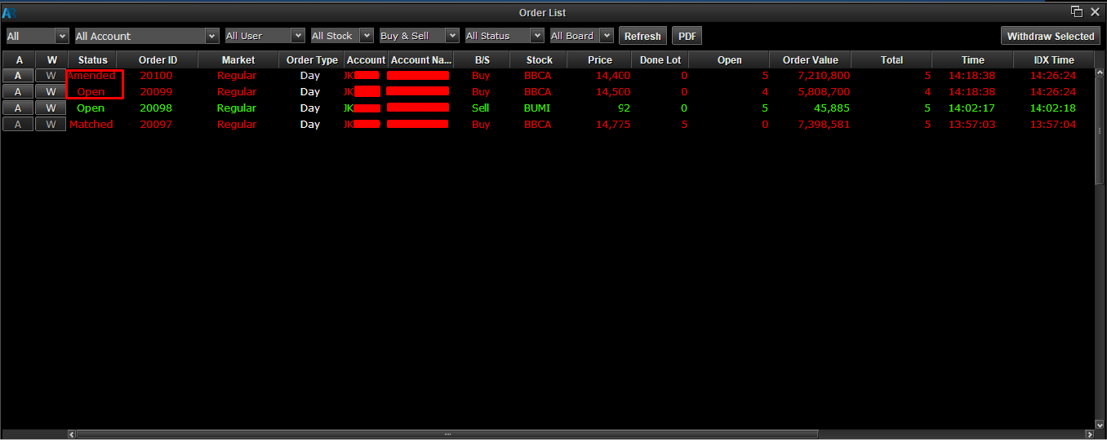
Amend Buy
Hasil Amend Buy

Slide 10
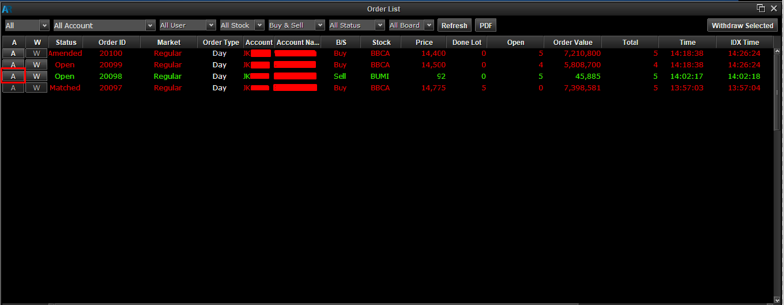
Amend Sell
Amend Sell
Pilih order tipe sell berstatus open yang ingin di-amend lalu pilih Amend

Slide 11
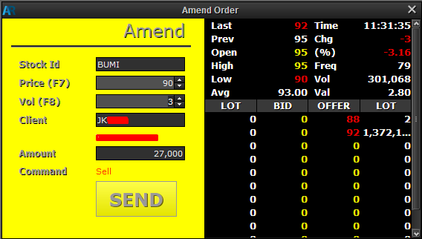
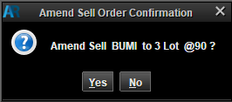
Amend Sell
Proses Amend Sell
Masukkan harga dan jumlah barang lalu klik Amend
Konfirmasi Amend Sell

Slide 12
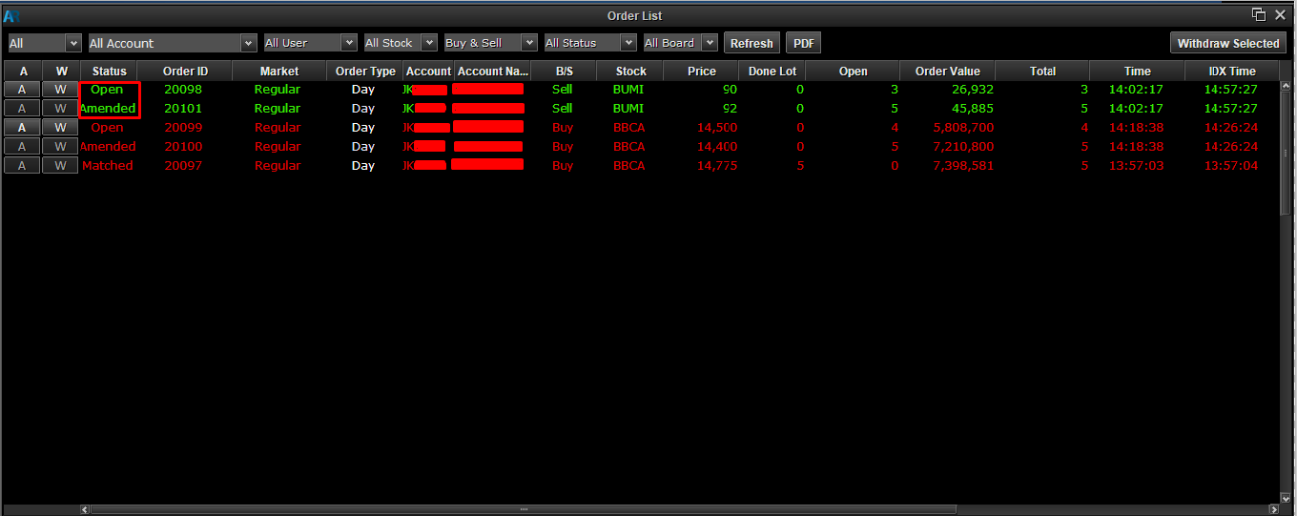
Amend Sell
Hasil Amend Sell

Slide 13
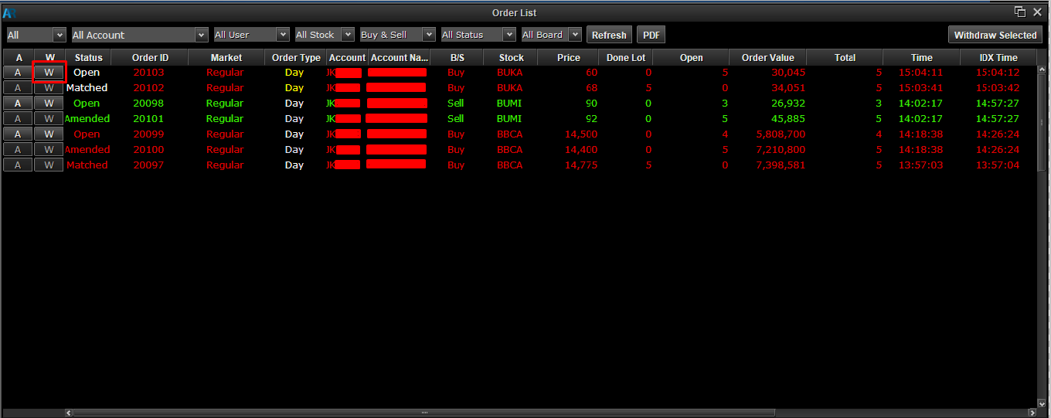
Withdraw Buy
Withdraw Buy
Pilih order tipe buy berstatus open yang ingin di-withdraw lalu pilih Withdraw

Slide 14
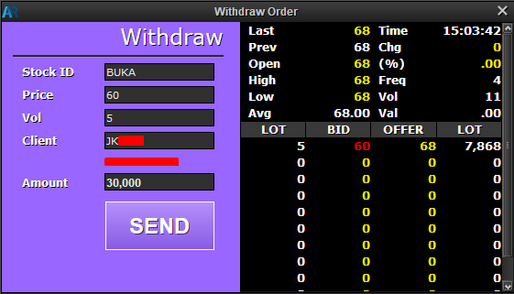
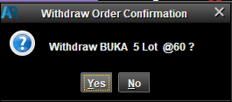
Withdraw Buy
Proses Withdraw
Masukkan harga dan jumlah barang lalu klik Amend
Konfirmasi Withdraw Buy

Slide 15
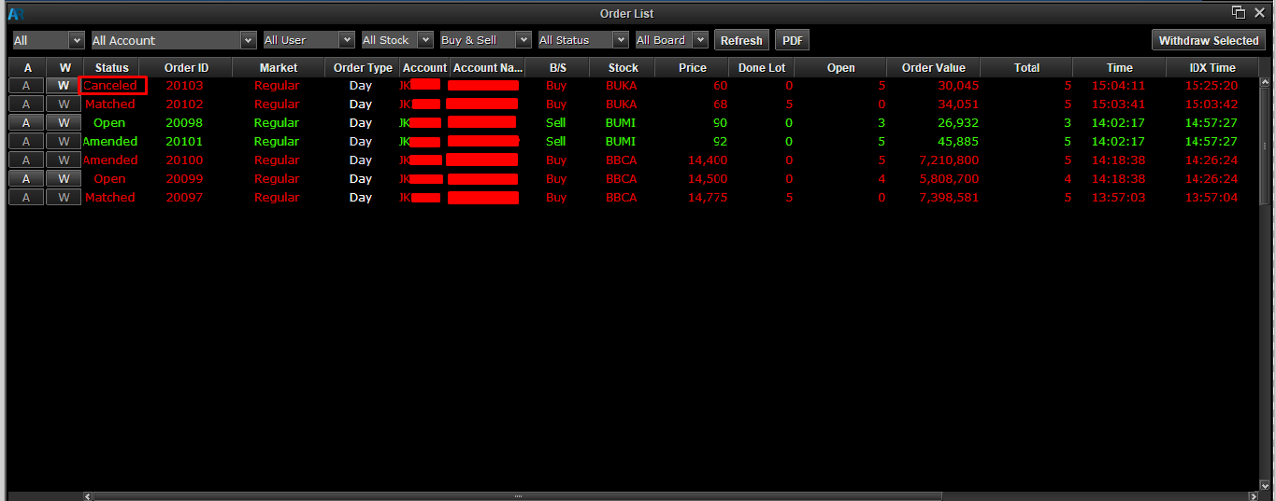
Withdraw Buy
Hasil Withdraw Buy

Slide 16
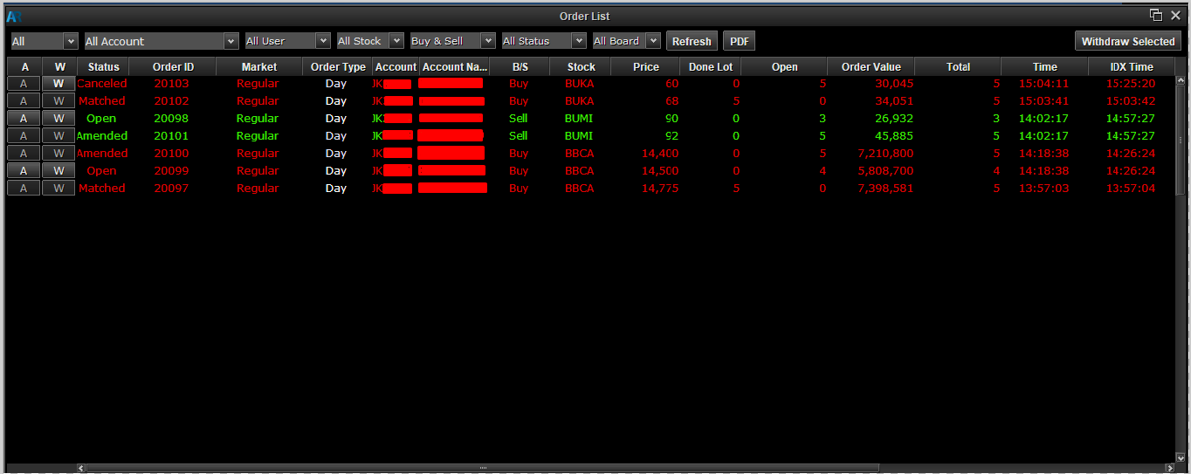
Order List

Slide 17
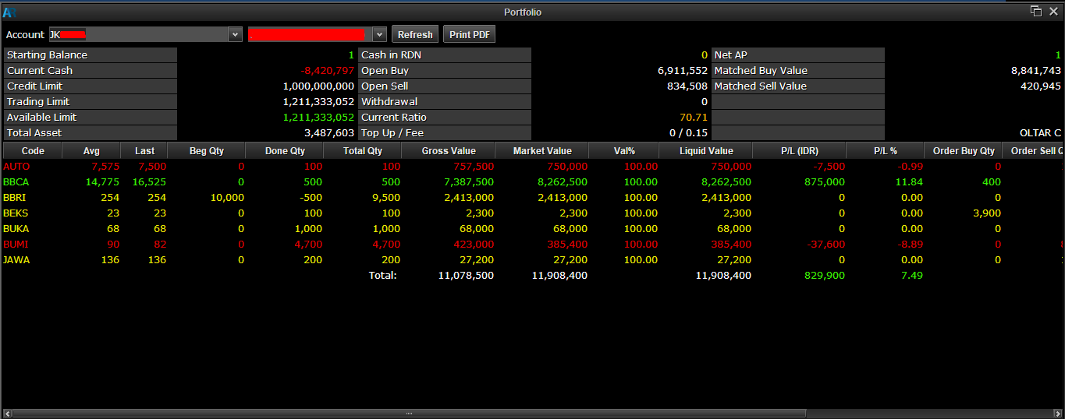
Portfolio

Slide 18
Gueline
Contact Person :
cs.olt@binaartha.com
(021) 5210340
Online Trading Web

